Slide 1
Array in MongoDB

Slide 2
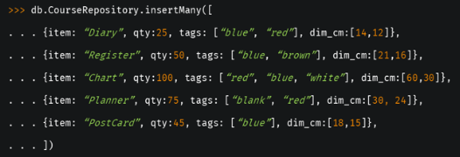
Array in MongoDB
Array is a list of values that can take many different forms.
Create a document:
db.Collection_name.operation({field: [“Val1”,“Val2”]})

Slide 3
Querying on Array
The find method can be used to return arrays inside a document.
Match an Array:
To specify equality condition on an array, use the query document { <field>: <value> } .
where <value> is the exact array to match, including the order of the elements.
Example:
Query 1: db.CourseRepository.find( { tags: [“blue", “red"] } )
Query 2: db.CourseRepository.find( { tags: { $all: [“blue", “red"] } } )

Slide 4

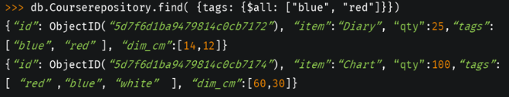
This query would return the document having tags “blue" and ”red", in the specified order.
To find an array that contains both the elements “blue" and ”red", without regard to order or other elements in the array, use the $all operator:

Slide 5
Query 1: db.CourseRepository.find( { tags: [“red", “blue"] } )
Query 2: db.CourseRepository.find( { tags: { $all: [“red", “blue"] } } )
Query 3: db.CourseRepository.find( { tags: [“red"] } )
Query 4: db.CourseRepository.find( { tags: {$all: [“red"] }} )
Query 5: db.CourseRepository.find( { tags: [“red", “white"] } )
Query 6: db.CourseRepository.find( { tags: { $all: [“red", “white"] } } )

Slide 6
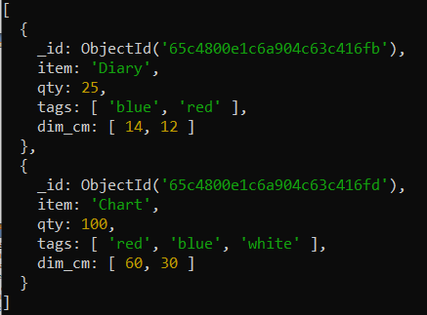
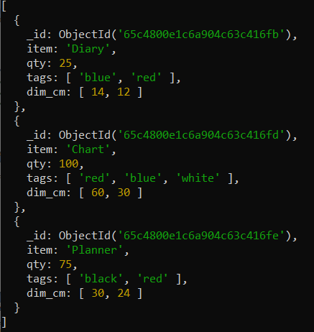
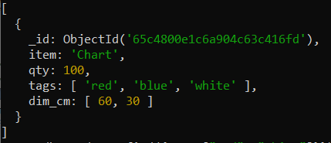
Query 2:
db.CourseRepository.find
( { tags: { $all: [“red", “blue"] } } )
Query 4:
db.CourseRepository.find
( { tags: {$all: [“red"] }} )
Query 6:
db.CourseRepository.find
( { tags: { $all: [“red", “white"] } } )

Slide 7
Query an Array for an Element:
To query if the array field contains at least one element with the specified value, use the filter { <field>: <value> } .
Example: db.CourseRepository.find( { tags: "red" } )
To specify conditions on the elements in the array field, use query operators in the query filter document:
Syntax: { <array field>: { <operator1>: <value1>, ... } }
Example: db.CourseRepository.find( { dim_cm: { $gt: 25 } } )
This operation queries for all documents where the array dim_cm contains at least one element whose value is greater than 25.

Slide 8
Specify Multiple Conditions for Array Elements
When specifying compound conditions on array elements, the query can be specified such that either a single array element meets these condition or any combination of array elements meets the conditions.
Query an Array with Compound Filter Conditions on the Array Elements: db.CourseRepository.find( { dim_cm: { $gt: 15, $lt: 20 } } )
This example queries for documents where the dim_cm array contains elements that in some combination satisfy the query conditions; e.g., one element can satisfy the greater than 15 condition and another element can satisfy the less than 20 condition, or a single element can satisfy both.

Slide 9
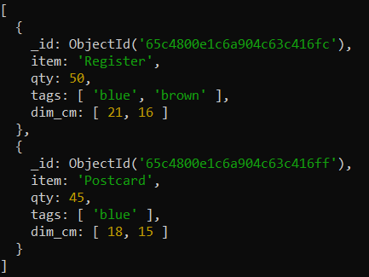
db.CourseRepository.find( { dim_cm: { $gt: 15, $lt: 20 } } )

Slide 10
Query for an Array Element that Meets Multiple Criteria:
Use $elemMatch operator to specify multiple criteria on the elements of an array such that at least one array element satisfies all the specified criteria.
db.CourseRepository.find( { dim_cm: { $elemMatch: { $gt: 22, $lt: 30 } } } )
This example queries for documents where the dim_cm array contains at least one element that is both greater than ($gt) 22 and less than ($lt) 30:
Query for an Element by the Array Index Position
Using the dot notation, you can specify query conditions for an element at a particular index or position of the array. The array uses zero-based indexing.
db. CourseRepository.find( { "dim_cm.1": { $gt: 25 } } )
This example queries for all documents where the second element in the array dim_cm is greater than 25.

Slide 11
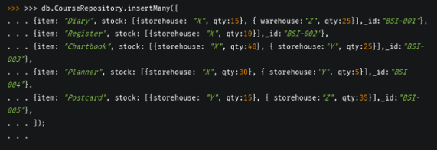
Query an Array by Array Length
Use the $size operator to query for arrays by number of elements.
db.CourseRepository.find( { "tags": { $size: 3 } } )
This query selects documents where array tags has 3 elements.
Nested array in MongoDB
when a set of field values is bundled inside a particular field in the form of an array, it is said to be “embedded” as a nested Array document.

Slide 12
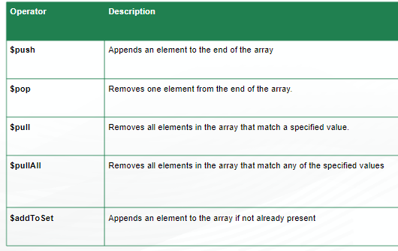
Array Update Operators

Slide 13
Array operator: $pop
The $pop operator removes the first or last element of an array.
Pass $pop a value of -1 to remove the first element of an array and 1 to remove the last element in an array.
The $pop operator has the form:
{ $pop: { <field>: <-1 | 1>, ... } }
The $pop operation fails if the <field> is not an array.
If the $pop operator removes the last item in the <field>, the <field> will then hold an empty array.

Slide 14


Examples
Remove the First Item of an Array:
Create the students collection:
Query: Remove first element, 8, from the scores array:
Output: The first element, 8, has been removed from the scores array:
Remove the Last Item of an Array
Remove the last element, 10, from the scores array by specifying 1:
The last element, 10, has been removed from the scores array:

Slide 15
Array operator: $pull
The $pull operator removes from an existing array all instances of a value or values that match a specified condition.
Syntax:
{ $pull: { <field1>: <value|condition>, <field2>: <value|condition>, ... } }
To specify a <field> in an embedded document or in an array, use dot notation.
If you specify a <condition> and the array elements are embedded documents, $pull operator applies the <condition> as if each array element were a document in a collection.
If the specified <value> to remove is a document, $pull removes only the elements in the array that have the exact same fields and values. The ordering of the fields can differ.

Slide 16
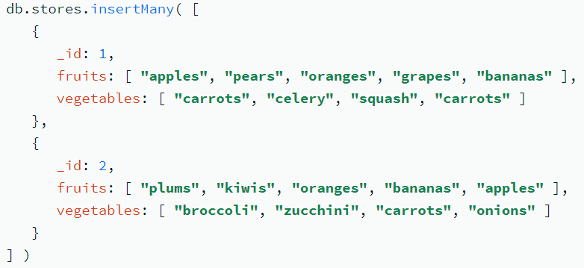
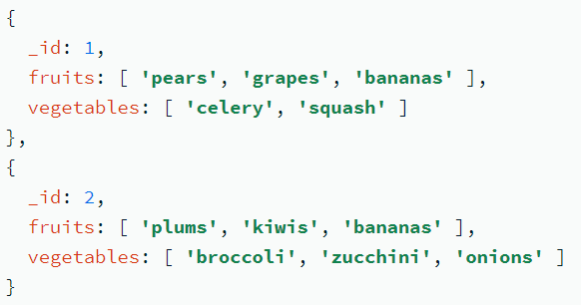
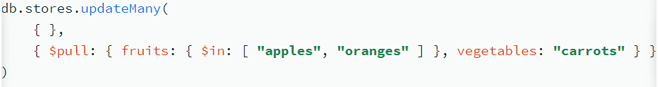
Array operator: $pull Examples
Remove All Items That Equal a Specified Value
Create the stores collection: 3) Output:
2) Query:
This operation removes
(i) "apples" and "oranges" from the fruits array
(ii) "carrots" from the vegetables array

Slide 17

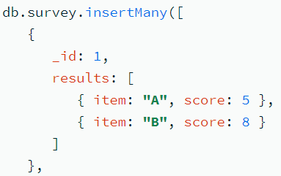
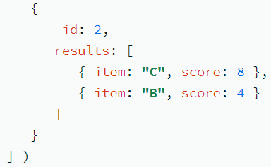
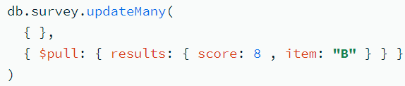
Remove All Items That Match a Specified $pull Condition
Create the profiles collection:
Remove all items from the votes array that are greater than or equal to ( $gte ) 6:
After the update operation, the document only has values less than 6:
Remove Items from an Array of Documents
Create the survey collection:
Removes all elements from the results array that contain both a score field equal to 8 and an item field equal to "B":

Slide 18
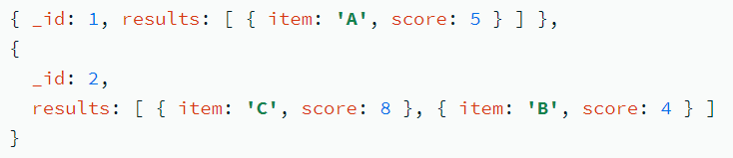
The $pull expression applies the condition to each element of the results array as though it were a top-level document.
After the operation, the results array contains no documents that contain both a score field equal to 8 and an item field equal to "B".
Create the survey collection:
Removes all elements from the results array that contain both a score field equal to 8 and an item field equal to "B":
Query:
Result:

Slide 19
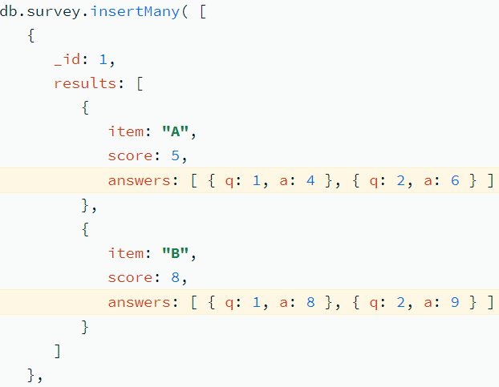
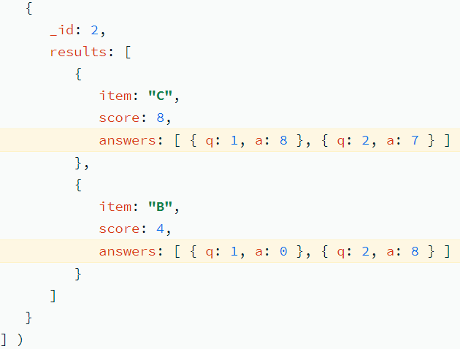
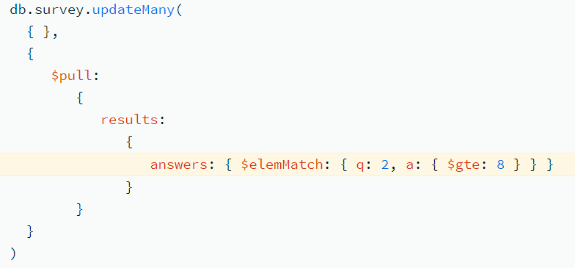
Remove Documents from Nested Arrays
Create a new survey collection with documents that are embedded in nested arrays.
Specify multiple conditions on the elements of the answers array with $elemMatch:

Slide 20
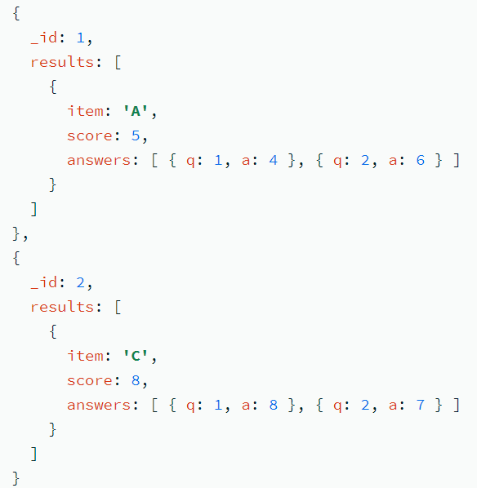

Slide 21
Array operator: $pullall
The $pullAll operator removes all instances of the specified values from an existing array.
Unlike the $pull operator that removes elements by specifying a query, $pullAll removes elements that match the listed values.
Syntax: { $pullAll: { <field1>: [ <value1>, <value2> ... ], .. } }
To specify a <field> in an embedded document or in an array, use dot notation.
Example: Create the survey collection:
Remove all instances of the values "0" and "5" from the scores array:
Output:

Slide 22
Array Update Operator: $push
The $push operator appends a specified value to an array.
Syntax: { $push: { <field1>: <value1>, ... } }
To specify a <field> in an embedded document or in an array, use dot notation.
If the field is absent in the document to update, $push adds the array field with the value as its element.
If the field is not an array, the operation will fail.
If the value is an array, $push appends the whole array as a single element. To add each element of the value separately, use the $each modifier with $push.

Slide 23
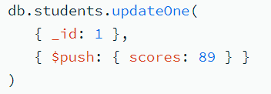
$push operator: Append a Value to an Array
Create the students collection:
The following example appends 89 to the scores array:
Output:

Slide 24
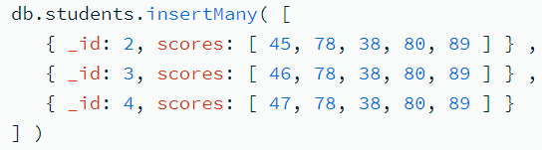
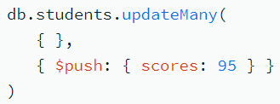

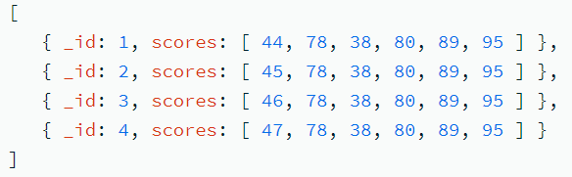
$push operator: Append a Value to Arrays in Multiple Documents
Add the following documents to the students collection:
The following $push operation appends 95 to the scores array in each document:
To confirm that each scores array includes 95, run the following operation:
Output

Slide 25
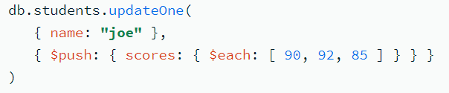
$push operator: Append Multiple Values to an Array
Use $push with the $each modifier to append multiple values to the array field.
The following example appends each element of [ 90, 92, 85 ] to the scores array for the document where the name field equals joe:

Slide 26
Array operator: $addToSet
The $addToSet operator adds a value to an array unless the value is already present, in which case $addToSet does nothing to that array.
Syntax:
{ $addToSet: { <field1>: <value1>, ... } }
To specify a <field> in an embedded document or in an array, use dot notation.
$addToSet only ensures that there are no duplicate items added to the set and does not affect existing duplicate elements.
$addToSet does not guarantee a particular ordering of elements in the modified set.

Slide 27
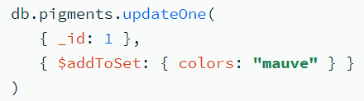
Missing Field:
If $addToSet used on a field that is absent from the document to update, $addToSet creates the array field with the specified value as its element.
Field is Not an Array:
If you use $addToSet on a field that is not an array, the operation will fail.
For example, create the pigments collection:
The colors field is not an array. The following $addToSet operation fails:

Slide 28
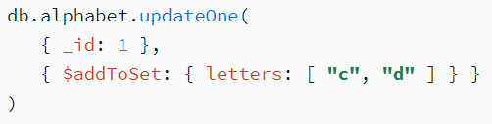
$addToSet: Value to Add is An Array
If the value is an array, $addToSet appends the whole array as a single element.
Create the alphabet collection:
The following operation appends the array [ "c", "d" ] to the letters field:
The array [ "c", "d" ] is added as a single element:
To add each element of the value separately, use the $each modifier with $addToSet.

Slide 29

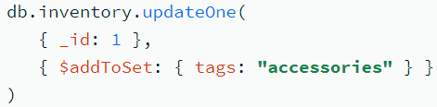
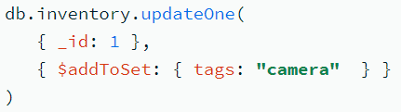
$addToSet: Value to Add is a Document
If the value is a document, MongoDB determines that the document is a duplicate if an existing document in the array matches the to-be-added document exactly; i.e. the existing document has the exact same fields and values and the fields are in the same order.
Add to Array: Add the element "accessories" to the tags array since "accessories" does not exist in the array.
Value Already Exists: $addToSet operation has no effect because "camera" is already an element of the tags array:

Slide 30
Modifiers
Modifier | Description
$each | Appends multiple values to the array field.
$slice | Limits the number of array elements. Requires the use of the $each modifier.
$sort | Orders elements of the array. Requires the use of the $each modifier.
$position | Specifies the location in the array at which to insert the new elements. Requires the use of the $each modifier. Without the $position modifier, the $push appends the elements to the end of the array.

Slide 31
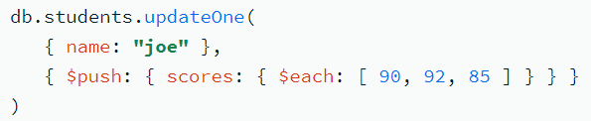
$each modifier
The $each modifier is available for use with the $addToSet operator and the $push operator.
Use with the $addToSet operator to add multiple values to an array <field> if the values do not exist in the <field>.
Use with the $push operator to append multiple values to an array <field>.
The $push operator can use $each modifier with other modifiers.
Use $each with $push Operator
The following example appends each element of [ 90, 92, 85 ] to the scores array for the document where the name field equals joe:

Slide 32
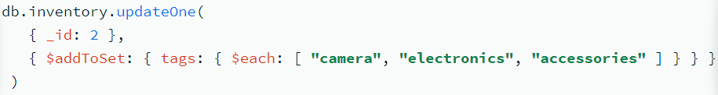
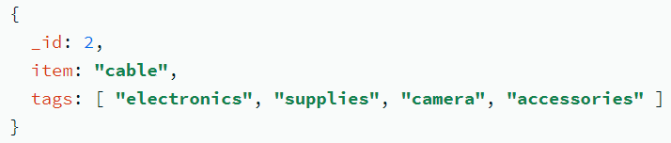
$each Modifier
You can use the $addToSet operator with the $each modifier. The $each modifier allows the $addToSet operator to add multiple values to the array field.
A collection inventory has the following document:
Then the following operation uses the $addToSet operator with the $each modifier to add multiple elements to the tags array:
The operation only adds "camera" and "accessories" to the tags array. "electronics" was already in the array:

Slide 33
$sort modifier
The $sort modifier orders the elements of an array during a $push operation.
To use the $sort modifier, it must appear with the $each modifier.
An empty array [] can pass to the $each modifier such that only the $sort modifier has an effect.
The $sort modifier can sort array elements that are not documents.
If the array elements are documents, the modifier can sort by either the whole document or by a specific field in the documents.
Trying to use the $sort modifier without the $each modifier results in an error.
The $sort no longer requires the $slice modifier.

Slide 34
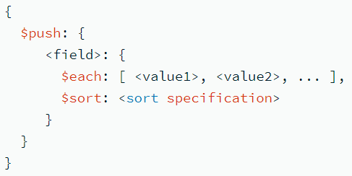
For <sort specification>:
To sort array elements that are not documents, or if the array elements are documents, to sort by the whole documents, specify 1 for ascending or -1 for descending.
If the array elements are documents, to sort by a field in the documents, specify a sort document with the field and the direction, i.e. { field: 1 } or { field: -1 }. Do not reference the containing array field in the sort specification. (e.g. { "arrayField.field": 1 } is incorrect).

Slide 35
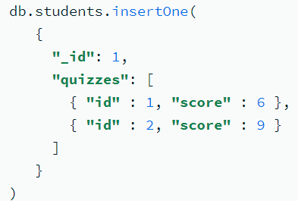
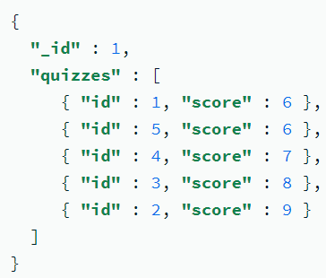
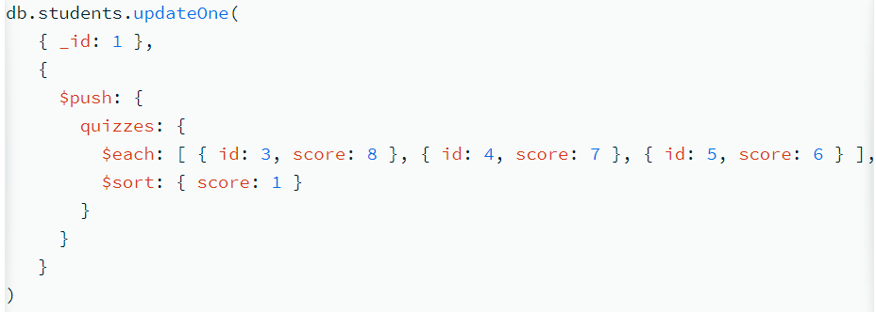
Sort Array of Documents by a Field in the Documents
1. Create the students collection: 3. Output:
2. Query: Append additional documents to the quizzes array and then sorts all the elements of the array by the ascending score field.
The sort document refers directly to the field in the documents and does not reference the containing array field quizzes; i.e. { score: 1 } and not { "quizzes.score": 1}

Slide 36
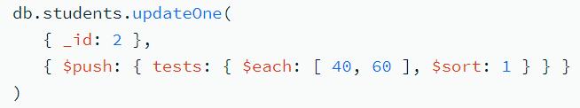
Sort Array Elements That Are Not Documents
Add the following document to the students collection:
Query: Add two more elements to the tests array and sorts the elements.
The updated document has the elements of the tests array in ascending order:

Slide 37
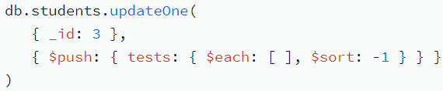
Update Array Using Sort Only
Add the following document to the students collection:
To update the tests field to sort its elements in descending order, specify the { $sort: -1 } and specify an empty array [] for the $each modifier. For example:
The example sorts the tests field values in descending order:

Slide 38
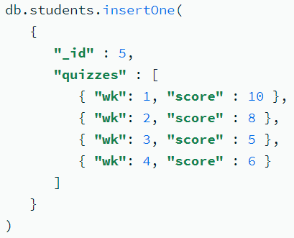
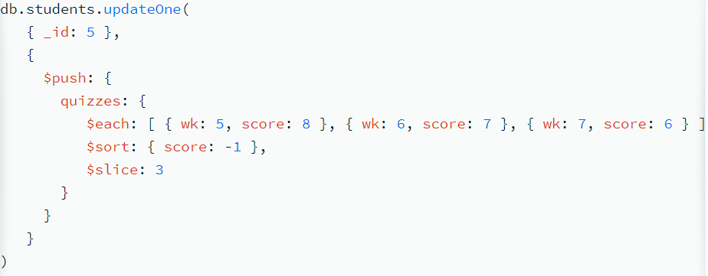
Use $sort with Other $push Modifiers
Add the following document to the students collection:

Slide 39
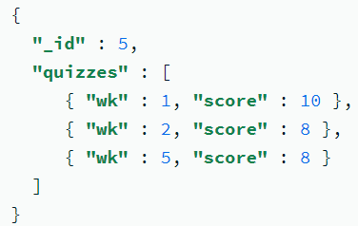
The $push operation uses:
the $each modifier to add multiple documents to the quizzes array,
the $sort modifier to sort all the elements of the modified quizzes array by the score field in descending order, and
the $slice modifier to keep only the first three sorted elements of the quizzes array.
After the operation only the three highest scoring quizzes are in the array:
The order of the modifiers in the query does not change the order that the modifiers are applied.

Slide 40
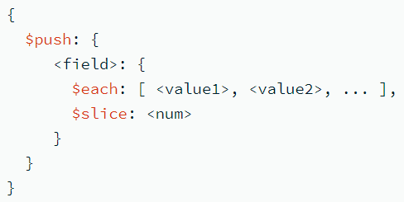
$slice modifier
The $slice modifier limits the number of array elements during a $push operation.
To use the $slice modifier, it must appear with the $each modifier. You can pass an empty array [] to the $each modifier such that only the $slice modifier has an effect.
Syntax:
The <num> can be:
Zero: To update the array <field> to an empty array.
Negative: To update the array <field> to contain only the last <num> elements.
Positive: To update the array <field> contain only the first <num> elements.

Slide 41
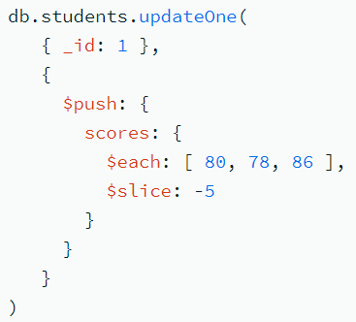
Slice from the end of the array
A collection students contains the following document:
Adds new elements to the scores array, and then uses the $slice modifier to trim the array to the last five elements:
The result of the operation is slice the elements of the updated scores array to the last five elements:

Slide 42
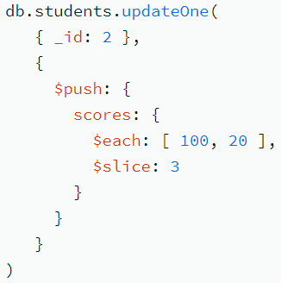
Slice from the Front of the Array
A collection students contains the following document:
Adds new elements to the scores array, and then uses the $slice modifier to trim the array to the first three elements.
The result of the operation is to slice the elements of the updated scores array to the first three elements:

Slide 43
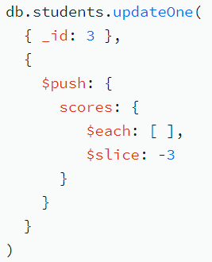
Update Array Using Slice Only
A collection students contains the following document:
To update the scores field with just the effects of the $slice modifier, specify the number of elements to slice (e.g. -3) for the $slice modifier and an empty array [] for the $each modifier, as in the following:
The result of the operation is to slice the elements of the scores array to the last three elements:

Slide 44
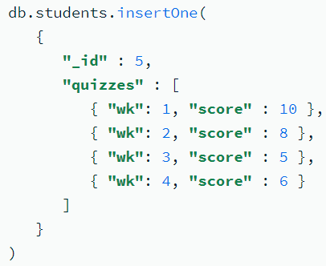
Use $slice with Other $push Modifiers
Add the following document to the students collection:
Perform the following $push operation uses:
the $each modifier to add multiple documents to the quizzes array,
the $sort modifier to sort all the elements of the modified quizzes array by the score field in descending order, and
the $slice modifier to keep only the first three sorted elements of the quizzes array.

Slide 45
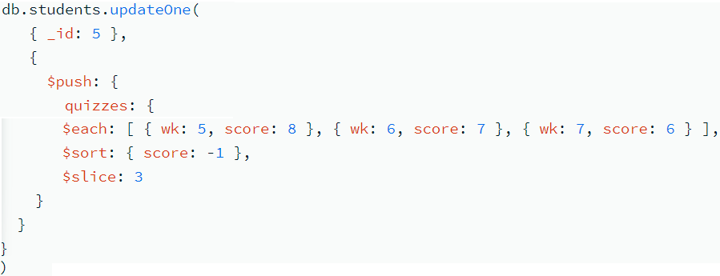
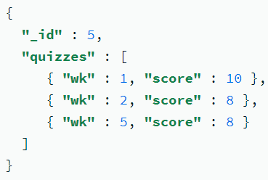
After the operation only the three highest scoring quizzes are in the array:
The order of the modifiers is immaterial to the order in which the modifiers are processed.

Slide 46
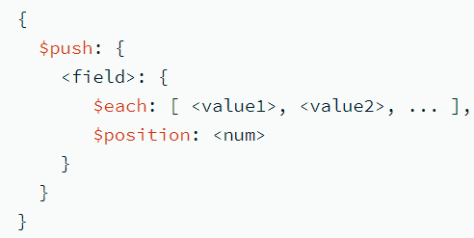
$position modifier
The $position modifier specifies the location in the array at which the $push operator inserts elements.
Without the $position modifier, the $push operator inserts elements to the end of the array.
To use the $position modifier, it must appear with the $each modifier.
Syntax:
<num> indicates the position in the array, based on a zero-based array index (position).

Slide 47
A non-negative number corresponds to the position in the array, starting from the beginning of the array.
If the value of <num> is greater or equal to the length of the array, the $position modifier has no effect and $push adds elements to the end of the array.
A negative number corresponds to the position in the array, counting from (but not including) the last element of the array.
For example, -1 indicates the position just before the last element in the array.
If you specify multiple elements in the $each array, the last added element is in the specified position from the end.
If the absolute value of <num> is greater than or equal to the length of the array, the $push adds elements to the beginning of the array.

Slide 48
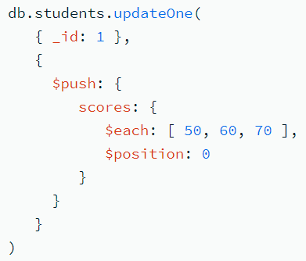
Examples
Add Elements at the Start of the Array
Create the students collection:
Update scores field to add the elements 50, 60 and 70 to the beginning of the array:
The operation results in the following updated document:

Slide 49
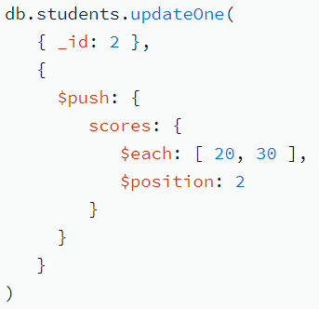
Add Elements to the Middle of the Array
Add a document to the students collection:
Update scores field to add the elements 20 and 30 at the array index (position) of 2:
The operation results in the following updated document:

Slide 50


Use a Negative Array Index (Position) to Add Elements to the Array
$position can accept a negative array index (position) value to indicate the position starting from the end, counting from (but not including) the last element of the array. For example, -1 indicates the position just before the last element in the array.
Example:
Query:
With a negative array index (position), if you specify multiple elements in the $each array, the last added element is in the specified position from the end.
Output:
This operation specifies -2 for the $position to add 90 at the position two places before the last element, and then 80 at the position two places before the last element.

Slide 51



Use $push Operator with Multiple Modifiers
the $each modifier to add multiple documents to the quizzes array,
the $sort modifier to sort all the elements of the modified quizzes array by the score field in descending order,
the $slice modifier to keep only the first three sorted elements of the quizzes array.
Output:

Slide 52
When used with modifiers, the $push operator has the form:
{ $push: { <field1>: { <modifier1>: <value1>, ... }, ... } }
The processing of the $push operation with modifiers occur in the following order, regardless of the order in which the modifiers appear:
Update array to add elements in the correct position.
Apply sort, if specified.
Slice the array, if specified.
Store the array.

